Slide 1
CSDS 451: Designing High Performant Systems for AI
Lecture 2
8/28/2025
Sanmukh Kuppannagari
sanmukh.kuppannagari@case.edu
https://sanmukh.research.st/
Case Western Reserve University

Slide 2
Outline
Why Performance Modeling?
Processor Memory Architectures
Basic Execution Model
Memory System Modeling

Slide 3
Outline
Why Performance Modeling?
Processor Memory Architectures
Basic Execution Model
Memory System Modeling

Slide 4
Performance Modeling
Identifying important parameters that determine the performance of an algorithm mapped to the platform
Algorithm – Parallel algorithm that we have designed
Platform – The target hardware on which we wish to run the parallel algorithm
Identifying equations that govern the performance

Slide 5
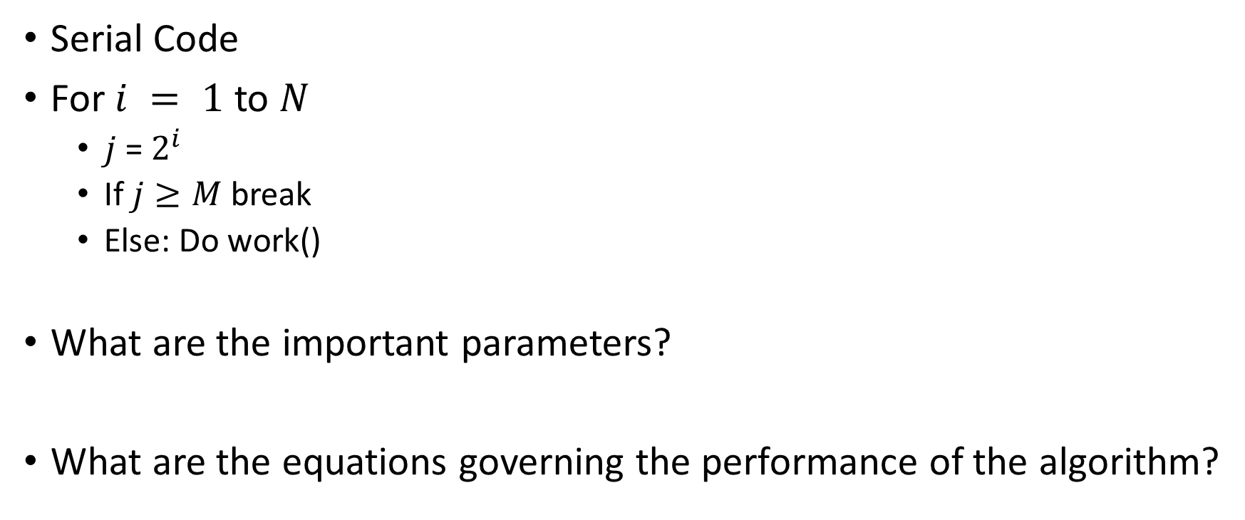
Why Performance Modeling?
Serial Code
For $i = 1$ to $N$
$j$ = $2^{i}$
If $j≥M$ break
Else: Do work()
What are the important parameters?
What are the equations governing the performance of the algorithm?

Slide 6
Why Performance Modeling?
Serial Code
For $i = 1$ to $N$
$j$ = $2^{i}$
If $j≥M$ break
Else: Do work()
What are the important parameters?
What are the equations governing the performance of the algorithm?
M,N
Min{log M,N}

Slide 7
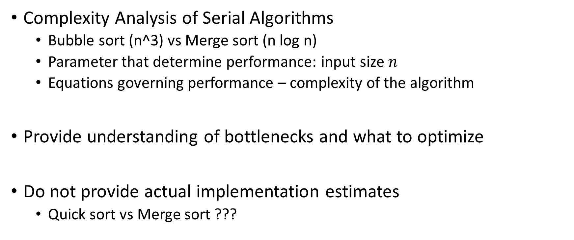
Why Performance Modeling?
Complexity Analysis of Serial Algorithms
Bubble sort (n^3) vs Merge sort (n log n)
Parameter that determine performance: input size $n$
Equations governing performance – complexity of the algorithm
Provide understanding of bottlenecks and what to optimize
Do not provide actual implementation estimates
Quick sort vs Merge sort ???

Slide 8
Parallel Algorithm Performance Modeling
Performance is platform dependent
Different platforms -> different parameters
Different platforms -> different equations governing performance

Slide 9
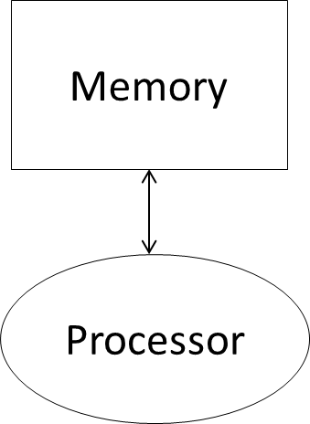
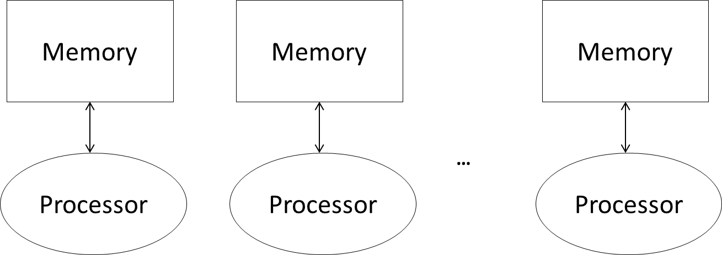
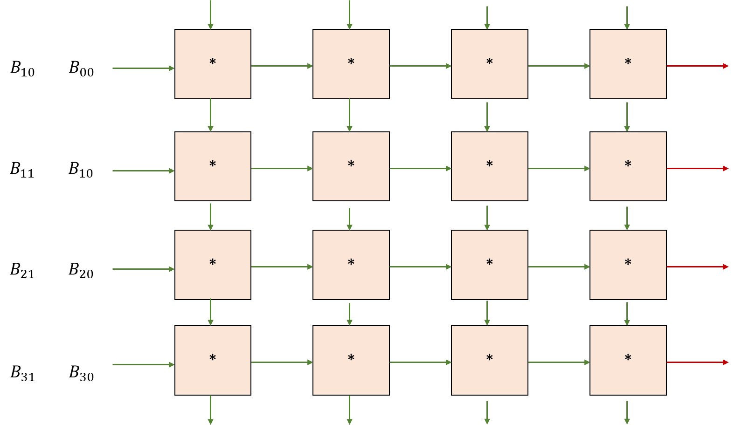
Targeted Platforms
Processor-Memory Architecture
CPUs, GPUs
Systolic Array Architecture
TPUs, Tensor Cores
Clusters
HPC

Slide 10
Why Performance Modeling?
Most importantly, to get a mental model of how the algorithm you are designing runs on the hardware, without going into specifics of the hardware.
Parallel programs can be notoriously hard to reason about
Simple performance models, even if not accurate, can help us get clarity on execution and aid in debugging

Slide 11
Outline
Why Performance Modeling?
Processor Memory Architectures
Basic Execution Model
Memory System Modeling

Slide 12
Basic Execution Model Fetch-Execute
A simple view
Memory
Fetch
Execute
Processor
Parameters:
Memory access = 1 cycle for any location
Execution = 1 cycle

Slide 13
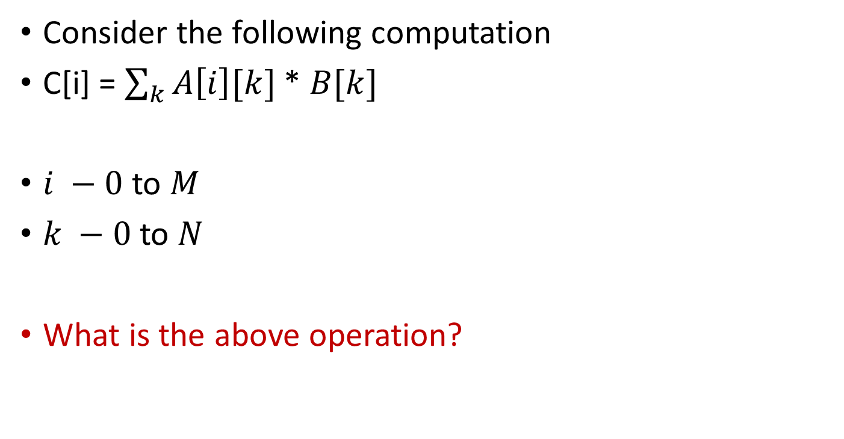
Basic Execution Model Calculating Algorithm Performance
Consider the following computation
C[i] = $\sum_{k}{A\left[i\right][k]}$ * $B[k]$
$i −0$to $M$
$k −0$ to $N$
What is the above operation?

Slide 14
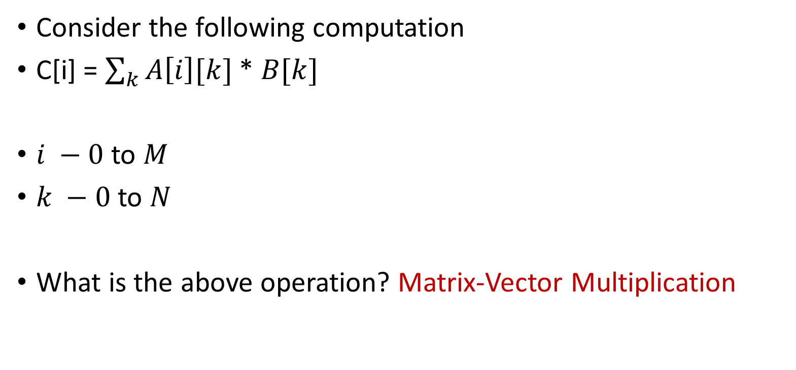
Basic Execution Model Calculating Algorithm Performance
Consider the following computation
C[i] = $\sum_{k}{A\left[i\right][k]}$ * $B[k]$
$i −0$to $M$
$k −0$ to $N$
What is the above operation? Matrix-Vector Multiplication

Slide 15
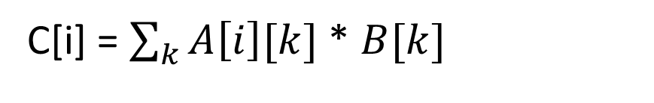
Matrix Vector Multiplication
C[i] = $\sum_{k}{A\left[i\right][k]}$ * $B[k]$
N
0
0
0,0
0,1
0,2
M
=
M
X
N
1
1
1,0
1,1
1,1
2
C
A
B

Slide 16
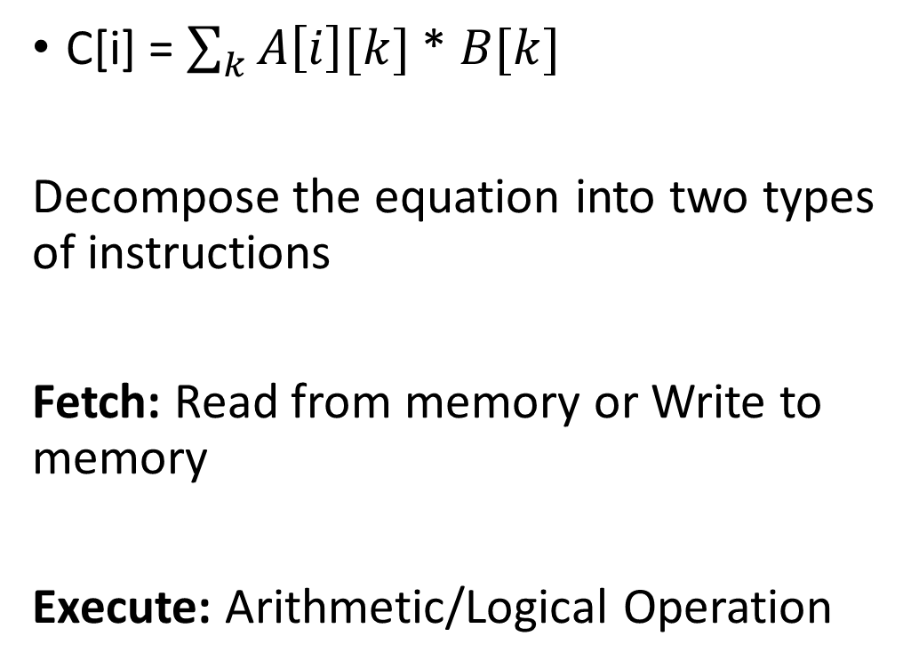
Basic Execution Model Calculating Algorithm Performance
C[i] = $\sum_{k}{A\left[i\right][k]}$ * $B[k]$
Decompose the equation into two types of instructions
Fetch: Read from memory or Write to memory
Execute: Arithmetic/Logical Operation
Memory
Processor

Slide 17
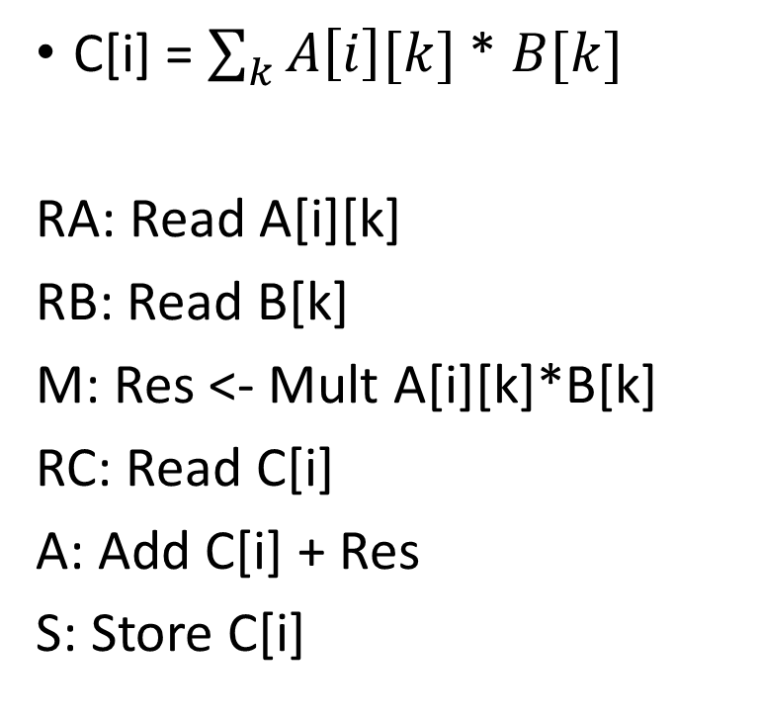
Basic Execution Model Calculating Algorithm Performance
C[i] = $\sum_{k}{A\left[i\right][k]}$ * $B[k]$
RA: Read A[i][k]
RB: Read B[k]
M: Res <- Mult A[i][k]*B[k]
RC: Read C[i]
A: Add C[i] + Res
S: Store C[i]
Memory
Processor

Slide 18
Basic Execution Model Calculating Algorithm Performance
C[i] = $\sum_{k}{A\left[i\right][k]}$ * $B[k]$
RA: Read A[i][k]
RB: Read B[k]
M: Res <- Mult A[i][k]*B[k]
RC: Read C[i]
A: Add C[i] + Res
S: Store C[i]
Assume we are storing these in a local memory (such as registers) in the processor
Memory
Processor

Slide 19
Basic Execution Model
Assumptions
No limit on the local memory
Putting a limit may require us to use a different set of instructions
Addition and Multiplications are each single cycle operations
Not necessarily true in modern architectures

Slide 20
Basic Execution Model Calculating Algorithm Performance
C[i] = $\sum_{k}{A\left[i\right][k]}$ * $B[k]$
RA: Read A[i][k]
RB: Read B[k]
M: Res <- Mult A[i][k]*B[k]
RC: Read C[i]
A: Add C[i] + Res
S: Store C[i]
6 cycles per entry of A
Total Time for the entire matrix = ??

Slide 21
Basic Execution Model Calculating Algorithm Performance
C[i] = $\sum_{k}{A\left[i\right][k]}$ * $B[k]$
RA: Read A[i][k]
RB: Read B[k]
M: Res <- Mult A[i][k]*B[k]
RC: Read C[i]
A: Add C[i] + Res
S: Store C[i]
6 cycles per entry of A
Total Time for the entire matrix = 6*M*N cycles

Slide 22
Basic Execution Model
Assume Processor is running at 2 GHz
Total time (in seconds) to execute Matrix-Vector Multiplication as per Basic Execution Model
???
Memory
2 Ghz
Processor

Slide 23
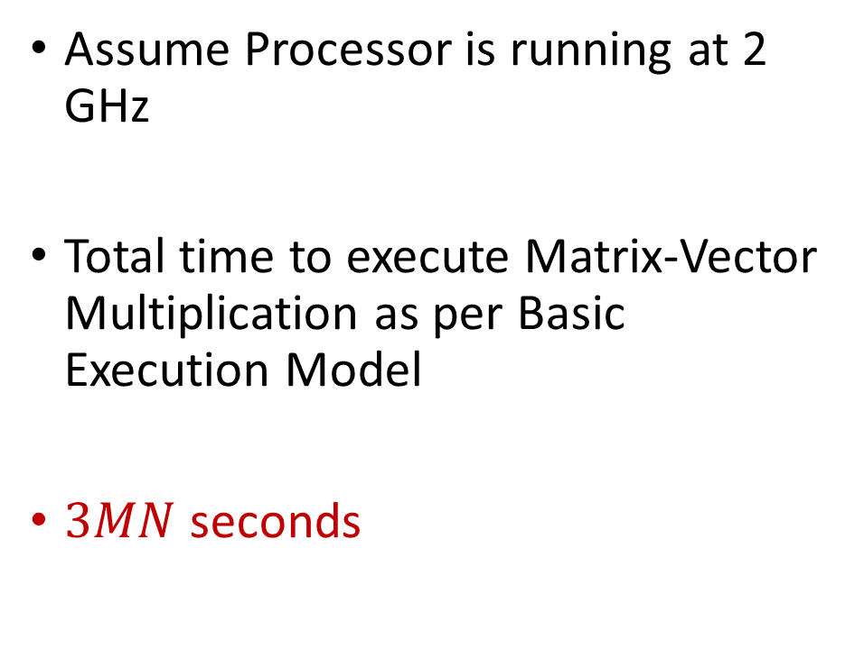
Basic Execution Model
Assume Processor is running at 2 GHz
Total time to execute Matrix-Vector Multiplication as per Basic Execution Model
$3MN$ seconds
Memory
2 Ghz
Processor

Slide 24
Basic Execution Model: Limitations
Does not account for memory transfer latencies
Does not account for differences in the number of cycles in various arithmetic operations
Multiplication usually requires more cycles than addition

Slide 25
Basic Execution Model: Uses
It will be a part of more complicated models that we will study next
With modern pipelined architectures, 1 cycle per execute operation is not a bad assumption

Slide 26
Outline
Why Performance Modeling?
Processor Memory Architectures
Basic Execution Model
Memory System Modeling

Slide 27
Memory System
System performance (execution time) depends on the “rate” at which data can be accessed by the program
M (DRAM)
Updated Execution Model
Latency: Time to receive the first word since the fetch instruction
Bandwidth: Rate of data transfer = bitwidth of the interconnect x frequency
64
P
Execute – 1 cycle
Fetch – Latency + Data size/bandwidth cycles

Slide 28
Memory System
System performance (execution time) depends on the “rate” at which data can be accessed by the program
M (DRAM)
Updated Execution Model
Latency: Time to receive the first word since the fetch instruction
Bandwidth: Rate of data transfer = bitwidth of the interconnect x frequency
64
P
Execute – 1 cycle
Fetch – Latency + Data size/bandwidth cycles

Slide 29
Memory System
Latency: Every fetch request requires some setup operation in memory before it can actually start transferring the data
Bandwidth: Once the data starts transferring, it can continuously transfer without any interruptions depending upon the speed of the interconnect, as long as it is contiguous
0
Fetch request: Given me 10 data elements starting at location 0

Slide 30
Memory System
Read A[0-31]
Latency: 10 cycles
Bandwidth: 8 data elements per cycle (assuming 8 bits/data element)
Number of cycles to finish the read operation?
M (DRAM)
64
P

Slide 31
Memory System
Read A[0-31]
Latency: 10 cycles
Bandwidth: 8 data elements per cycle (assuming 8 bits/data element)
Number of cycles to finish the read operation? 10 + 4 = 14 cycles
M (DRAM)
64
P

Slide 32
Memory System
Read A[0-31], A[32-63], A[64-95]
Latency: 10 cycles
Bandwidth: 8 data elements per cycle (assuming 8 bits/data element)
Number of cycles to finish the read operation?
M (DRAM)
64
P

Slide 33
Memory System
Read A[0-31], A[32-63], A[64-95]
Latency: 10 cycles
Bandwidth: 8 data elements per cycle (assuming 8 bits/data element)
Number of cycles to finish the read operation? 10 + 4 + 10 + 4 + 10 + 4 = 42 cycles
M (DRAM)
64
P

Slide 34
Memory System
Read A[0-95]
Latency: 10 cycles
Bandwidth: 8 data elements per cycle (assuming 8 bits/data element)
Number of cycles to finish the read operation?
M (DRAM)
64
P

Slide 35
Memory System
Read A[0-95]
Latency: 10 cycles
Bandwidth: 8 data elements per cycle (assuming 8 bits/data element)
Number of cycles to finish the read operation? 10 + 12 = 22 cycles
M (DRAM)
64
P

Slide 36
Memory System
By fetching the entire 96 words in a single go, we saved 20 cycles
Prefetching:
If you know what data your algorithm needs to access beforehand (not as easy as it sounds)
Prefetch it to save on latency
(Note: above 20 cycles is based on a simple model, in reality, it is difficult to exactly calculate the savings, but we do see substantial savings)

Slide 37
Memory System
System performance (execution time) depends on the “rate” at which data can be accessed by the program
M (DRAM)
Updated Execution Model
Latency: Time to receive the first word since the fetch instruction
Bandwidth: Rate of data transfer = bitwidth of the interconnect x frequency
64
P
Execute – 1 cycle
Fetch – Latency + Data size/bandwidth cycles

Slide 38
Memory System
Latency: Every fetch request requires some setup operation in memory before it can actually start transferring the data
Bandwidth: Once the data starts transferring, it can continuously transfer without any interruptions depending upon the speed of the interconnect, as long as it is contiguous
0
Fetch request: Given me 10 data elements starting at location 0

Slide 39
Memory System: Modeling
Performance will be measured in terms of “System Performance Metric”
Number of “useful computations” performed per second
Useful computation – arithmetic computations such as Add, Mult, etc.
Does not include memory fetching time in calculations

Slide 40
System Performance Metric
FLOPs – Floating Point Operations Per Second
Number of useful “floating point” operations in a second
GFLOPs – Giga (1024) Floating Point Operations Per Second
Note: Unless explicitly specified, we will use 64 bit floating point as data type for performance modeling in this class.
We will call each data element as a word

Slide 41
System Performance Metric
1024 read operations
For every two read operations, we perform one add operation.
All the operations mentioned above take a total of 10 seconds.
What is the system performance?

Slide 42
System Performance Metric
1024 read operations
For every two read operations, we perform one add operation.
All the operations mentioned above take a total of 10 seconds.
What is the system performance? 512 Floating point operations in 10 seconds

Slide 43
System Performance Metric
1024 read operations
For every two read operations, we perform one add operation.
All the operations mentioned above take a total of 10 seconds.
What is the system performance? 51.2 FLOPs

Slide 44
System Performance Metric
1024 read operations
For every two read operations, we perform one add operation.
All the operations mentioned above take a total of 10 seconds.
What is the system performance? 0.05 GFLOPs

Slide 45
Memory System Modeling
M (DRAM)
Processor
2 Ghz (0.5 ns per cycle)
Memory
Memory Latency = 10 ns (20 cycles)
Bandwidth = 64 bits at 1 GHz
(64 Gbits/sec or 8 GB/sec) or
(64 bits in every 2 processor cycles)
64
P

Slide 46
Memory System Modeling
We will consider three metrics:
Peak Performance
Sustained Performance (best case)
Sustained Performance (worst case)
Actual obtained performance on the hardware should be somewhere in between Sustained Performance (worst case) and Peak Performance
If not, there was some error in modeling or the implementation of the algorithm
It can be higher or lower than the Sustained Performance (best case), this information governs what optimizations to use

Slide 47
Memory System Modeling: Peak Performance
Captures the Raw Computer power of the processor (memory not considered)
Peak Performance = Clock Rate X Num ops per cycle
= 2 (Ghz) x 1 (ops/cycle)
= 2 Giga Ops per Second
If Floating point ops = 2 GFLOPs (Giga Floating Point Operations per second)

Slide 48
Memory System Modeling: Peak Performance
Captures the Raw Computer power of the processor (memory not considered)
Peak Performance = Clock Rate X Num ops per cycle
= 2 (Ghz) x 1 (ops/cycle)
= 2 Giga Ops per Second
If Floating point ops = 2 GFLOPs (Giga Floating Point Operations per second)
For multiple processors/GPUs, this number will change

Slide 49
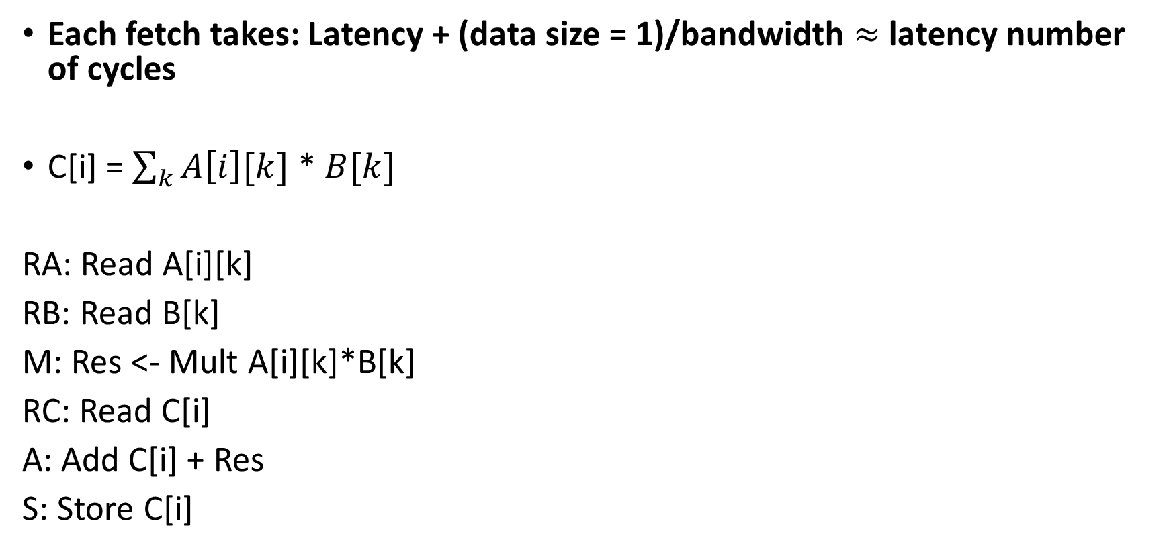
Memory System Modeling: Sustained Performance (Worst Case)
Each fetch takes: Latency + (data size = 1)/bandwidth $≈$ latency number of cycles
C[i] = $\sum_{k}{A\left[i\right][k]}$ * $B[k]$
RA: Read A[i][k]
RB: Read B[k]
M: Res <- Mult A[i][k]*B[k]
RC: Read C[i]
A: Add C[i] + Res
S: Store C[i]
Latency
Latency
1
Latency
1
Latency

Slide 50
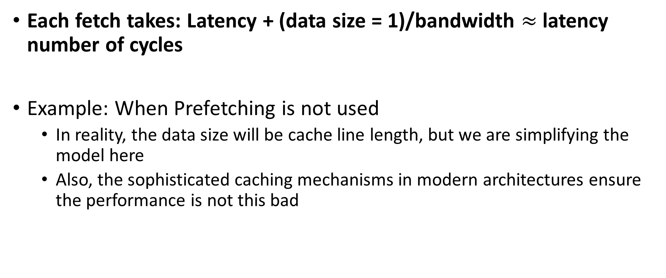
Memory System Modeling: Sustained Performance (Worst Case)
Each fetch takes: Latency + (data size = 1)/bandwidth $≈$ latency number of cycles
Example: When Prefetching is not used
In reality, the data size will be cache line length, but we are simplifying the model here
Also, the sophisticated caching mechanisms in modern architectures ensure the performance is not this bad

Slide 51
Memory System Modeling: Sustained Performance (Worst Case)
M (DRAM)
Processor
2 Ghz (0.5 ns per cycle)
Memory
Memory Latency = 10 ns (20 cycles)
Bandwidth = 64 bits at 1 GHz
(64 Gbits/sec or 8 GB/sec) or
(64 bits in every 2 processor cycles)
64
P
Can you calculate the Sustained Performance (worst case) in GFLOPs for the entire matrix?

Slide 52

Memory System Modeling: Sustained Performance (Worst Case)
Fetch = ??
Execute = ??
Total time (per each loop over $i$) = $??$
Number of Operations (per each loop over $i$) = ??
Performance: ?? GFLOPs

Slide 53
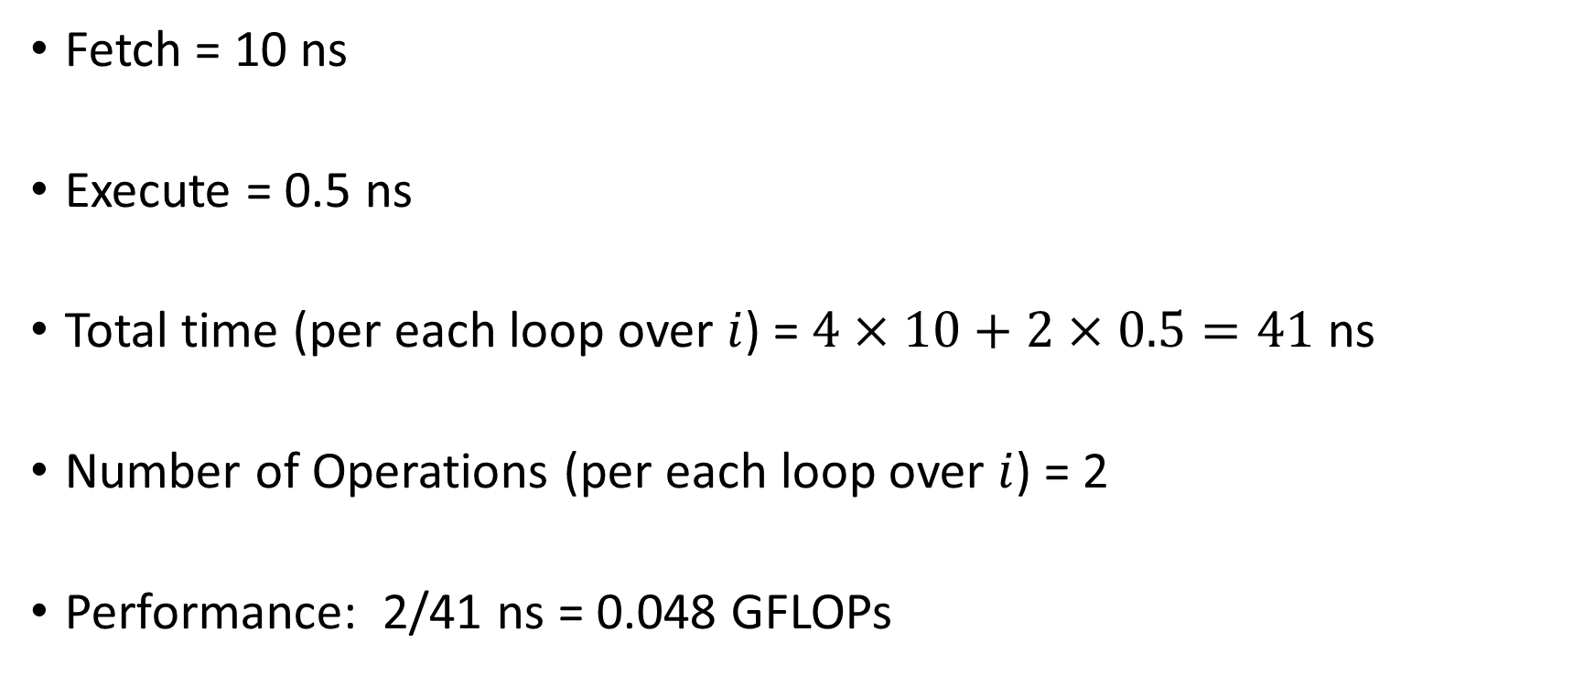
Memory System Modeling: Sustained Performance (Worst Case)
Fetch = 10 ns
Execute = 0.5 ns
Total time (per each loop over $i$) = $4×10+2×0.5=41$ ns
Number of Operations (per each loop over $i$) = 2
Performance: 2/41 ns = 0.048 GFLOPs

Slide 54
Memory System Modeling: Sustained Performance (Best Case)
In Sustained Performance (worst case), we were fetching one word at a time.
Separate fetch instructions
Each instruction incurring latency
Sustained Performance (best case): Assume data is contiguously stored
Single fetch can be performed
Assume latency is 0
M (DRAM)
64
P

Slide 55
Memory System Modeling: Sustained Performance (Best Case)
How can the latency be 0?
Data prefetching: Processor initiates data transfer request way before the data is actually needed
Predicting data prefetching parameters using ML is a hot research topic: https://scholar.google.com/scholar?as_ylo=2018&q=data+prefetching+machine+learning&hl=en&as_sdt=0,36
We will not cover in this class

Slide 56
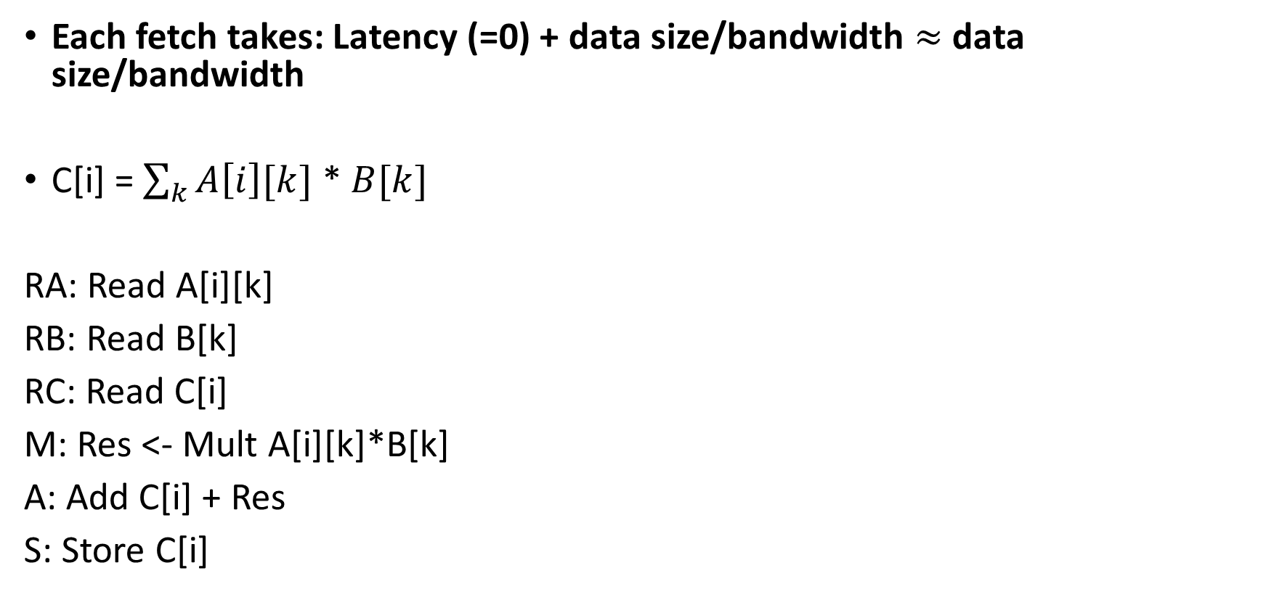
Memory System Modeling: Sustained Performance (Best Case)
Each fetch takes: Latency (=0) + data size/bandwidth $≈$ data size/bandwidth
C[i] = $\sum_{k}{A\left[i\right][k]}$ * $B[k]$
RA: Read A[i][k]
RB: Read B[k]
RC: Read C[i]
M: Res <- Mult A[i][k]*B[k]
A: Add C[i] + Res
S: Store C[i]
Single Fetch at rate of bandwidth
1
1
Single Fetch at the rate of bandwidth

Slide 57
Memory System Modeling: Sustained Performance (Best Case)
Each fetch takes: Latency (=0) + data size/bandwidth $≈$ data size/bandwidth
C[i] = $\sum_{k}{A\left[i\right][k]}$ * $B[k]$
RA: Read A[i][k]
RB: Read B[k]
RC: Read C[i]
M: Res <- Mult A[i][k]*B[k]
A: Add C[i] + Res
S: Store C[i]
Time in ns??
Time in ns??
Time in ns??
Time in ns??

Slide 58
Memory System Modeling: Sustained Performance (Best Case)
M (DRAM)
Processor
2 Ghz (0.5 ns per cycle)
Memory
Memory Latency = 10 ns (20 cycles)
Bandwidth = 64 bits at 1 GHz
(64 Gbits/sec or 8 GB/sec) or
(64 bits in every 2 processor cycles)
64
P
Can you calculate the Sustained Performance (best case) in GFLOPs for the entire matrix?

Slide 59
Memory System Modeling: Sustained Performance (Worst Case)
Each fetch takes: Latency (=0) + data size/bandwidth $≈$ data size/bandwidth
C[i] = $\sum_{k}{A\left[i\right][k]}$ * $B[k]$
RA: Read A[i][k]
RB: Read B[k]
RC: Read C[i]
M: Res <- Mult A[i][k]*B[k]
A: Add C[i] + Res
S: Store C[i]
3 ns
0.5 ns
0.5 ns
1 ns

Slide 60
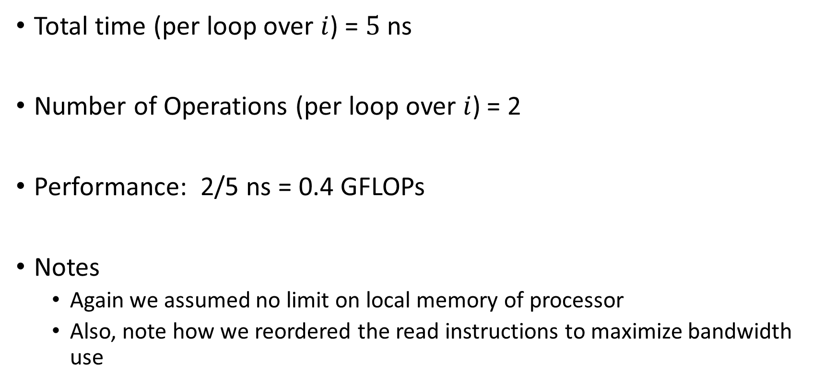
Memory System Modeling: Sustained Performance (Best Case)
Total time (per loop over $i$) = $5$ ns
Number of Operations (per loop over $i$) = 2
Performance: 2/5 ns = 0.4 GFLOPs
Notes
Again we assumed no limit on local memory of processor
Also, note how we reordered the read instructions to maximize bandwidth use

Slide 61
System Performance Metrics
Actual System Performance
Latency Hiding Mechanisms
Efficient Bandwidth Utilization
0.048 Gflops/s
0.4 Gflops/s
2 Gflops/s
Sustained Worst Case
Latency dominant
Sustained Best Case
Latency Hidden
Memory bandwidth dominant
Peak Performance
Compute Only

Slide 62
Memory System: Conclusion
A simple model to perform “pen and paper” calculations to analyze an algorithm
Compare various algorithms in a similar spirit as complexity analysis
Get a mental model of the algorithm execution to potentially find better optimizations

Slide 63
Memory System: Conclusion
Ungraded HW assignment 1: Can you create a simple code to perform these calculations? (May help you in your assignments later)

Slide 64
Next Class
9/2 Lecture 3 – Processor-Memory Architecture II
Memory Optimizations,
Processor Memory Architectures with Cache
Blocked Matrix Multiplication

Slide 65
Thank You
Questions?
Email: sanmukh.kuppannagari@case.edu

